Slide 1
스프링 프레임워크

Slide 2
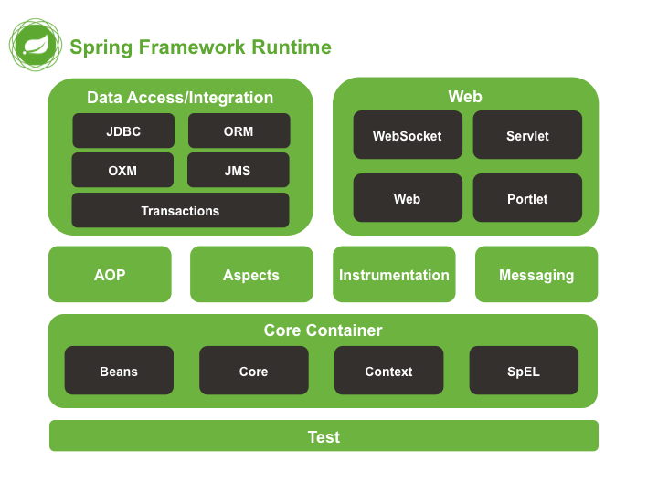
스프링 프레임워크 구성도

Slide 3
스프링프레임워크 종류
1. Spring MVC : 웹 애플리케이션 MVC 프레임워크
2. Spring Batch : 배치 처리용 프레임워크
3. Spring Security : 인증, 허가 프레임워크
4. Spring Integration : 시스템 연계 프레임워크
5. Spring Data : 데이터 접근 추상화 프레임워크

Slide 4
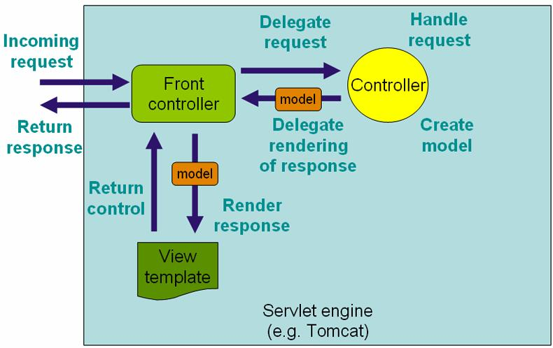
Front Controller

Slide 5
스프링부트의 특징
1. 자주사용하는 프로젝트 조합을 미리 준비해놓았습니다.
2. 설정을 자동으로 수행한다.
3. 서버를 포함하고 있다.

Slide 6
스프링부트 로딩 순서
MVC 설정
Security 설정
JDBC 설정
JPA 설정
AOP 설정

Slide 7
application.yml
server: port: 8084 spring: datasource: url: jdbc:h2:mem:AZ;DB_CLOSE_DELAY=-1;DB_CLOSE_ON_EXIT=FALSE driver-class-name: org.h2.Driver username: sa password: jpa: database-platform: org.hibernate.dialect.H2Dialect show-sql: true profiles: active: product logging: level: org.springframework.web: DEBUG
compile('org.springframework.boot:spring-boot-starter-data-jpa') compile('com.h2database:h2')
@Profile("product")

Slide 8
build.gradle – 웹 백앤드 패키지 관리
jar { baseName = 'jpaboardproject' version = '0.0.1-SNAPSHOT' } sourceCompatibility = 1.8 targetCompatibility = 1.8 dependencies { compile('org.springframework.boot:spring-boot-starter-data-jpa') compile('org.springframework.boot:spring-boot-starter-web') compile('com.h2database:h2') compile("org.springframework.boot:spring-boot-starter-actuator") // lombok compile("org.projectlombok:lombok:1.12.2") // tiles compile "org.apache.tiles:tiles-core:${tileVersion}", "org.apache.tiles:tiles-template:${tileVersion}", "org.apache.tiles:tiles-jsp:${tileVersion}" // jsp, jstl compile('javax.servlet:jstl') compile('org.apache.tomcat.embed:tomcat-embed-jasper') testCompile "org.springframework.boot:spring-boot-starter-test" testCompile "org.codehaus.groovy:groovy-all:${groovyVersion}" testCompile "org.spockframework:spock-spring" }
gradle 간단한 명령어
gradle build : 빌드
gradle clean : 정리
gradle bootRun : 자동실행
gradle clean build bootRun : 한번에 실행

Slide 9
@configuration 자바 파일 설정
import org.springframework.context.annotation.Bean; import org.springframework.context.annotation.Configuration; import org.springframework.context.annotation.Profile; import org.springframework.web.servlet.ViewResolver; import org.springframework.web.servlet.config.annotation.EnableWebMvc; import org.springframework.web.servlet.config.annotation.ResourceHandlerRegistry; import org.springframework.web.servlet.config.annotation.WebMvcConfigurerAdapter; import org.springframework.web.servlet.view.InternalResourceViewResolver; import org.springframework.web.servlet.view.tiles3.TilesConfigurer; import org.springframework.web.servlet.view.tiles3.TilesView; import org.springframework.web.servlet.view.tiles3.TilesViewResolver;
@Profile("product") // 배포시에만 사용함. @Configuration @EnableWebMvc public class ControllerConfiguration extends WebMvcConfigurerAdapter {
profiles: active: product
@SpringBootApplication public class JpaBoardProjectApplication {
// resource 아래 내용이 없으면 resource 폴더 위치를 못 찾습니다. private static final String[] CLASSPATH_RESOURCE_LOCATIONS = { "classpath:/META-INF/resources/", "classpath:/resources/", "classpath:/static/", "classpath:/public/" };
/** * resource static 파일 설정 * @param registry */ @Override public void addResourceHandlers(ResourceHandlerRegistry registry) { registry.addResourceHandler("/**").addResourceLocations(CLASSPATH_RESOURCE_LOCATIONS); }

Slide 10
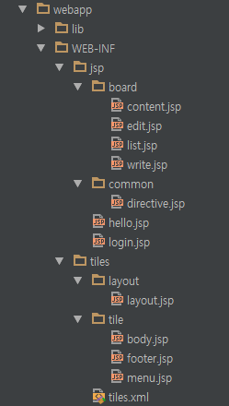
@configuration 자바 파일 설정
/** * jsp bean 설정 resolver * @return */ @Bean public ViewResolver internalResourceViewResolver() { InternalResourceViewResolver internalResourceViewResolver = new InternalResourceViewResolver(); internalResourceViewResolver.setPrefix("/WEB-INF/jsp/"); internalResourceViewResolver.setSuffix(".jsp"); internalResourceViewResolver.setOrder(2); return internalResourceViewResolver; } /** * tiles bean xml 설정파일 * @return */ @Bean public TilesConfigurer tilesConfigurer() { TilesConfigurer tilesConfigurer = new TilesConfigurer(); tilesConfigurer.setDefinitions("/WEB-INF/tiles/tiles.xml"); tilesConfigurer.setCheckRefresh(true); return tilesConfigurer; } /** * tiles bean 설정 resolver * @return */ @Bean public TilesViewResolver tilesViewResolver() { TilesViewResolver viewResolver = new TilesViewResolver(); viewResolver.setViewClass(TilesView.class); viewResolver.setOrder(1); return viewResolver; }

Slide 11
tiles.xml
<?xml version="1.0" encoding="UTF-8"?> <!DOCTYPE tiles-definitions PUBLIC "-//Apache Software Foundation//DTD Tiles Configuration 2.0//EN" "http://tiles.apache.org/dtds/tiles-config_2_0.dtd"> <tiles-definitions> <!-- default : 템플릿에 설정된 페이지의 구성 요소에 대한 실제 파일을 지정합니다. --> <definition name="default" template="/WEB-INF/tiles/layout/layout.jsp"> <put-attribute name="title" value="한글"/> <put-attribute name="menu" value="/WEB-INF/tiles/tile/menu.jsp" /> <put-attribute name="body" value="/WEB-INF/tiles/tile/body.jsp" /> <put-attribute name="footer" value="/WEB-INF/tiles/tile/footer.jsp" /> </definition> <definition name="*.tiles" extends="default"> <put-attribute name="body" value="/WEB-INF/jsp/{1}.jsp" /> </definition> <definition name="/board/*.tiles" extends="default"> <put-attribute name="body" value="/WEB-INF/jsp/board/{1}.jsp" /> </definition> <definition name="*.jsp" extends="no-tiles"> <put-attribute name="noTemplate" value="/WEB-INF/jsp/{1}.jsp" /> </definition> </tiles-definitions>

Slide 12
directive.jsp
<%@ taglib prefix="c" uri="http://java.sun.com/jsp/jstl/core"%> <%@ taglib prefix="fn" uri="http://java.sun.com/jsp/jstl/functions"%> <%@ taglib prefix="fmt" uri="http://java.sun.com/jsp/jstl/fmt"%> <%@ taglib prefix="spring" uri="http://www.springframework.org/tags"%> <%@ taglib prefix="form" uri="http://www.springframework.org/tags/form"%> <%@ taglib prefix="tiles" uri="http://tiles.apache.org/tags-tiles"%>
<%@ page language="java" contentType="text/html; charset=UTF-8" pageEncoding="UTF-8"%> <%@ include file="/WEB-INF/jsp/common/directive.jsp"%> <!DOCTYPE> <html> <head> <meta charset="UTF-8"> <meta http-equiv="X-UA-Compatible" content="IE=edge" /> <title><tiles:insertAttribute name="title"/></title> <link href="<c:url value="/bower_components/bootstrap/dist/css/bootstrap.css"/>" rel="stylesheet"> <link rel="stylesheet" href="https://maxcdn.bootstrapcdn.com/font-awesome/4.5.0/css/font-awesome.min.css"> <script type="text/javascript" src="<c:url value="/bower_components/jquery/dist/jquery.min.js"/>"></script> <!--[if lt IE 9]> <script src="https://oss.maxcdn.com/libs/html5shiv/3.7.0/html5shiv.js"></script> <script src="https://oss.maxcdn.com/libs/respond.js/1.4.2/respond.min.js"></script> <![endif]--> <script> $(document).ready(function () { }); </script> </head> <body> <tiles:insertAttribute name="menu" /> <tiles:insertAttribute name="body" /> <tiles:insertAttribute name="footer" /> </body> </html>

Slide 13
bower.json – 웹 프론트앤드 패키지 관리자
{ "name": "webapp", "authors": [ "kimyongyeon <toyongyeon@gmail.com>" ], "description": "", "main": "", "moduleType": [], "license": "MIT", "homepage": "", "ignore": [ "**/.*", "node_modules", "bower_components", "src/main/resources/static/bower_components", "test", "tests" ], "dependencies": { "jquery": "~3.1.0", "bootstrap": "~3.3.7" } }
http://nodejs.org/download/
https://nodejs.org/en/
npm install -g bower
bower install jquery
설치경로 : 현재폴더위치 / components / jquery
한번에 여러 컴포넌트 설치하고 싶다면,
bower install jquery bootstrap
버전 지정 방법 : bower install jquery#1.9.1
컴포넌트 제거 방법 : bower uninstall jquery
컴포넌트 설치 목록 확인방법 : bower list 혹은 bower ls
현재 폴더 / 하위에 설치된 컴포넌트들의 목록을 확인 한다.
원하는 컴포넌트가 존재하는지 찾고 싶다면 ? bower search d3

Slide 14
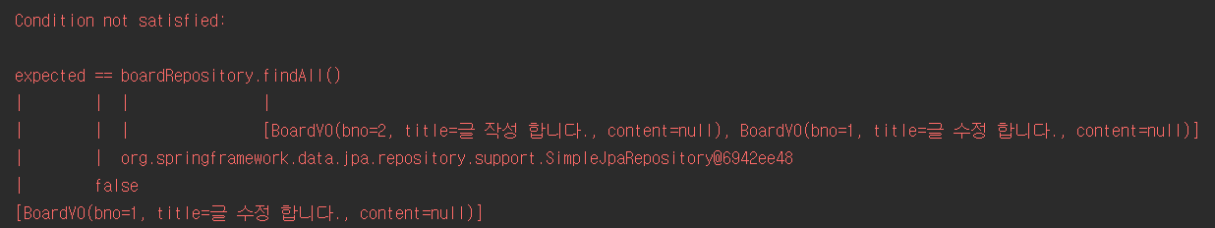
spock 테스트 방법
@ContextConfiguration // not mentioned by docs, but had to include this for Spock to startup the Spring context @SpringBootTest(webEnvironment = SpringBootTest.WebEnvironment.RANDOM_PORT) class BoardBasicTest extends Specification{
@Autowired BoardRepository boardRepository;
import spock.lang.Specification
def "글을 작성 합니다."() { given: BoardVO b = new BoardVO() b.setTitle("글 작성 합니다."); when: def expected = boardRepository.save(b).findAll() then: expected == boardRepository.findAll() }

